Slide 1
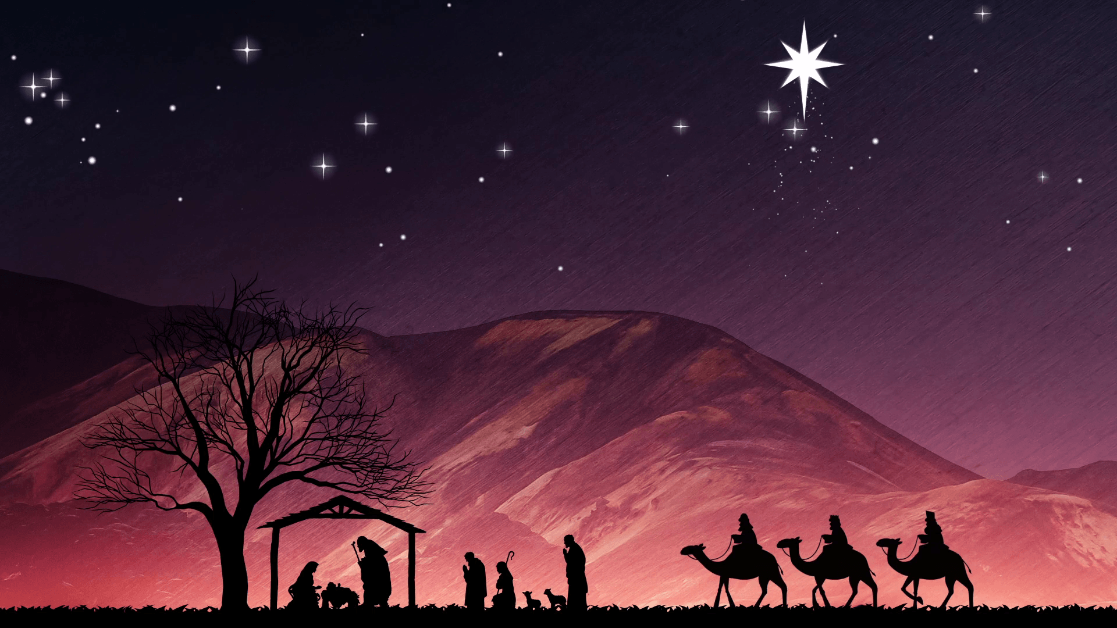
马槽歌
Away In A Manger
121

Slide 2
遠遠在馬槽裡，無枕也無床，
小小的主耶穌，睡覺很安康；
Away in a manger, no crib for a bed,
The little Lord Jesus laid down His sweet head.

Slide 3
眾明星都望著，主睡的地方！
小小的主耶穌，睡在乾草上。
The stars in the bright sky looked down where He lay,
The little Lord Jesus asleep in the hay.

Slide 4
眾牲畜嗚嗚叫，聖嬰忽驚醒，
小小的主耶穌，卻無啼哭聲。
The cattle are lowing, the Baby awakes,
But little Lord Jesus no crying He makes.

Slide 5
我真愛主耶穌，敬求近我身，
靠近我的床邊，守我到天明。
I love Thee Lord Jesus, look down from the sky,
And stay by my side until morning is night.

Slide 6
恭敬求主耶穌 靠近我身旁
愛護我接受我 做主的小羊
Be near me, Lord Jesus; I ask Thee to stay,
Close by me forever, and love me I pray.

Slide 7
也保護眾孩童 一齊都安康
教我們都能夠 跟主到天堂
Bless all the dear children in Thy tender care,
And fit us for Heaven to live with Thee there.

